Slide 1



Cyber Safety Solutions
PRESENTED BY
Muhammad Ibrahim
Phishing Awareness Training
Stay Safe Online with Us

Slide 2




What is Phishing?
Phishing is a deceptive tactic used by cybercriminals to trick users into revealing sensitive information, often through fraudulent emails or websites.

Slide 3



Types of Phishing
EMAIL PHISHING
Fraudulent emails that appear legitimate to trick users into providing sensitive information.
WEBSITE PHISHING
Fake websites designed to mimic real ones and steal login credentials.
SOCIAL ENGINEERING
Manipulative tactics used to deceive individuals into divulging personal information.

Slide 4
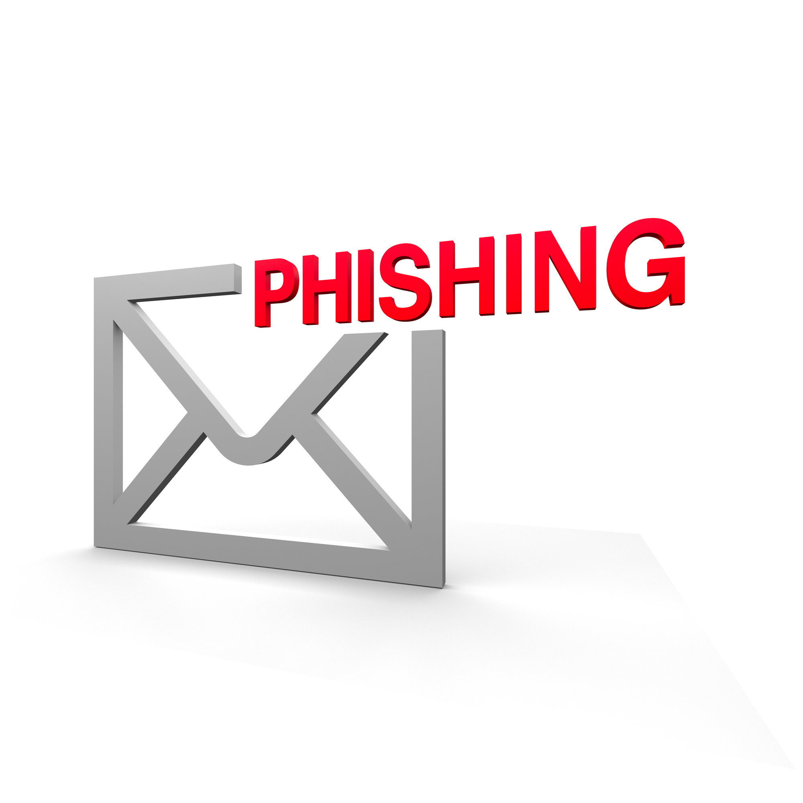


Spotting Phishing Emails
Recognizing red flags in emails, such as suspicious links and unfamiliar senders, is crucial for staying safe and avoiding potential scams.

Slide 5

Phishing Websites
To avoid fraudulent sites, always check the URL for secure connections and look for signs of legitimacy before providing sensitive information.

Slide 6

Social Engineering Tactics
Understanding manipulation strategies is crucial for recognizing deceitful practices. Attackers often exploit emotions to gain trust and extract sensitive information from their targets.

Slide 7

Protect Yourself
To ensure your online safety, always use strong passwords, enable two-factor authentication, and never click on suspicious links in emails.

Slide 8


500,000
Average losses per incident
What to Do Next
Financial impact of phishing
Steps to take right after falling for a phishing attack
95%
Phishing incidents reported
Percentage of organizations affected

Slide 9

Quick Quiz
Test your knowledge on phishing awareness with these questions. Understanding these concepts is crucial for staying safe in today's digital landscape.

Slide 10

Final Tips
To ensure your online safety, regularly update your passwords and use two-factor authentication for added security on all accounts.

